Slide 1
Data Analytics findings of Olympic Medal Winners Data Set
We use libraries such as NumPy, Pandas, matplotlib in Python to plot these figures and charts depicting interesting patterns and trends.

Slide 2
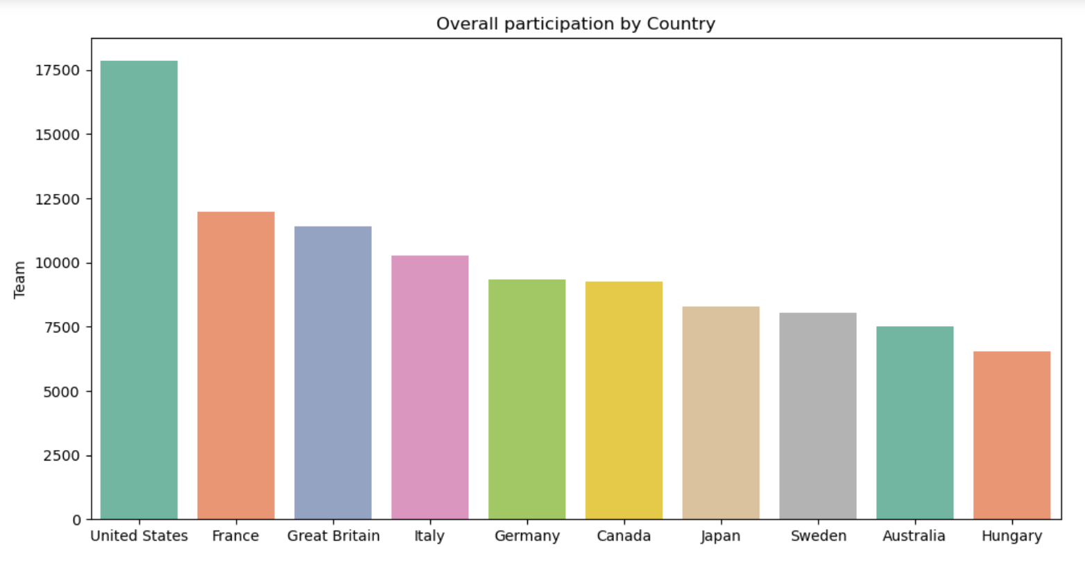
Country Wise Participation of Athletes

Slide 3
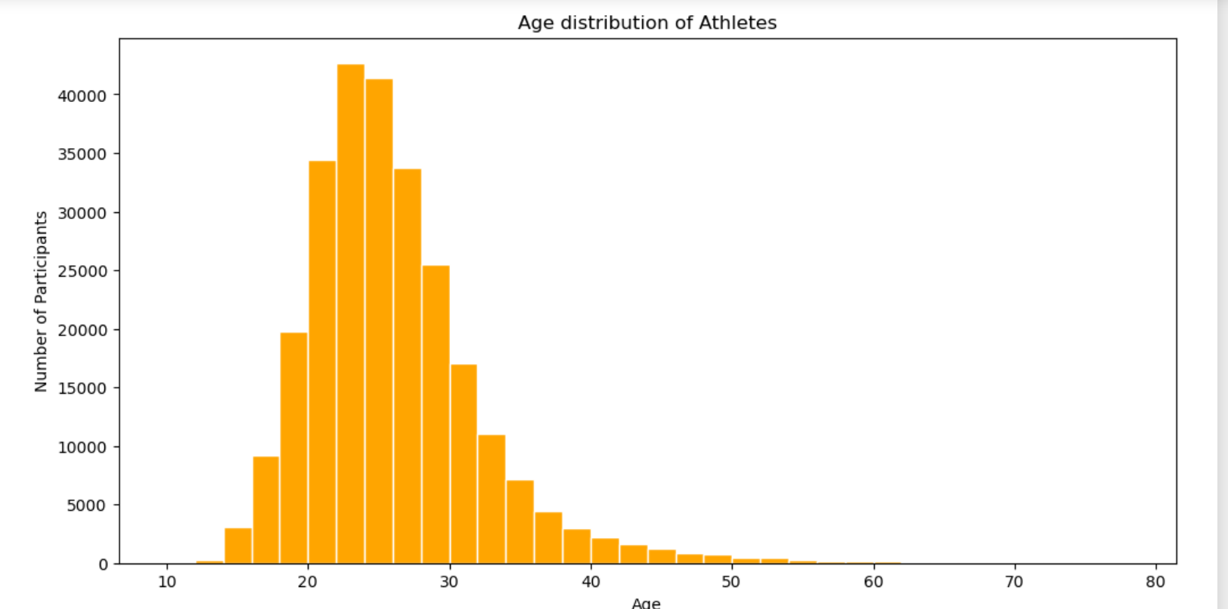
Distribution of Athletes as per Age

Slide 4
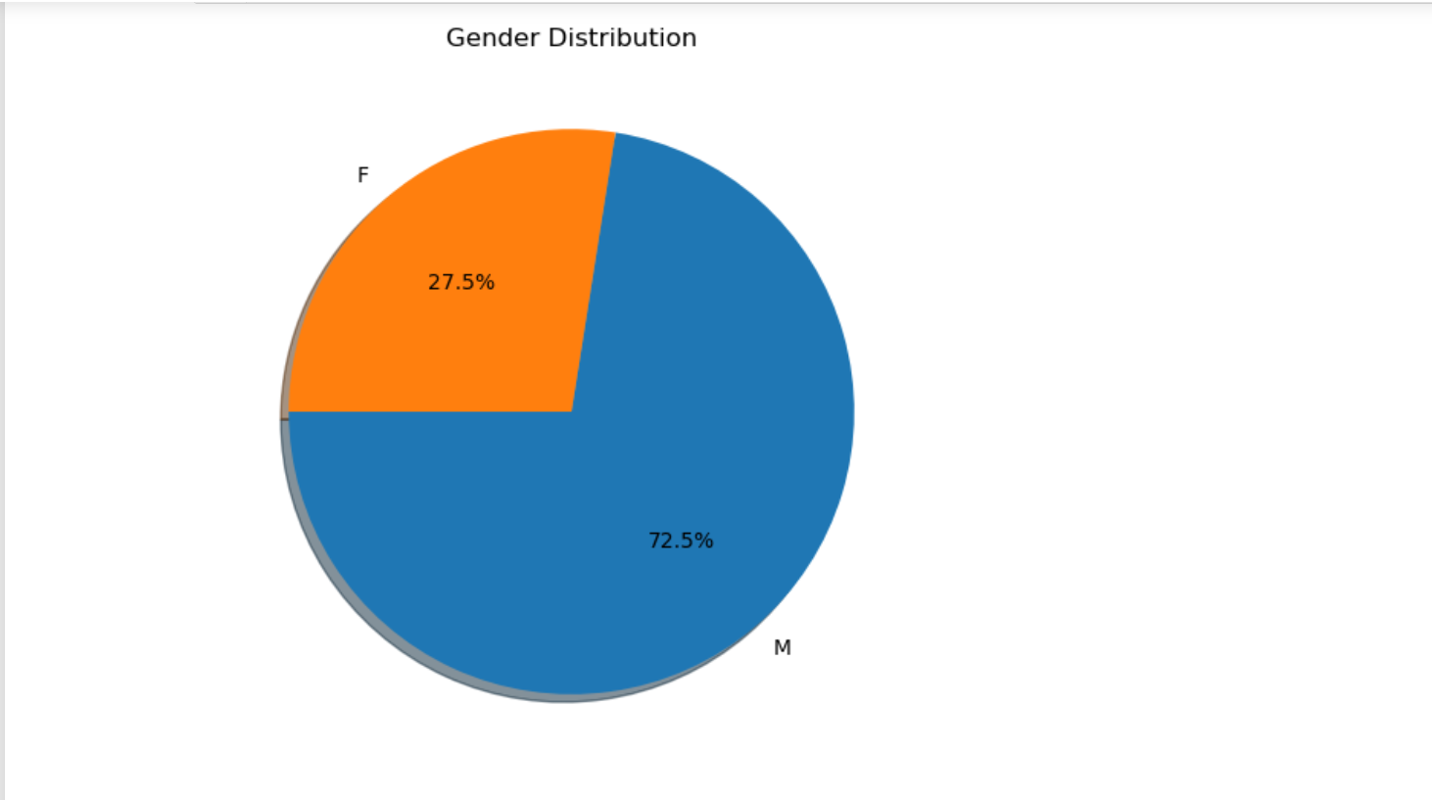
Percentage of Males & Females Athletes

Slide 5
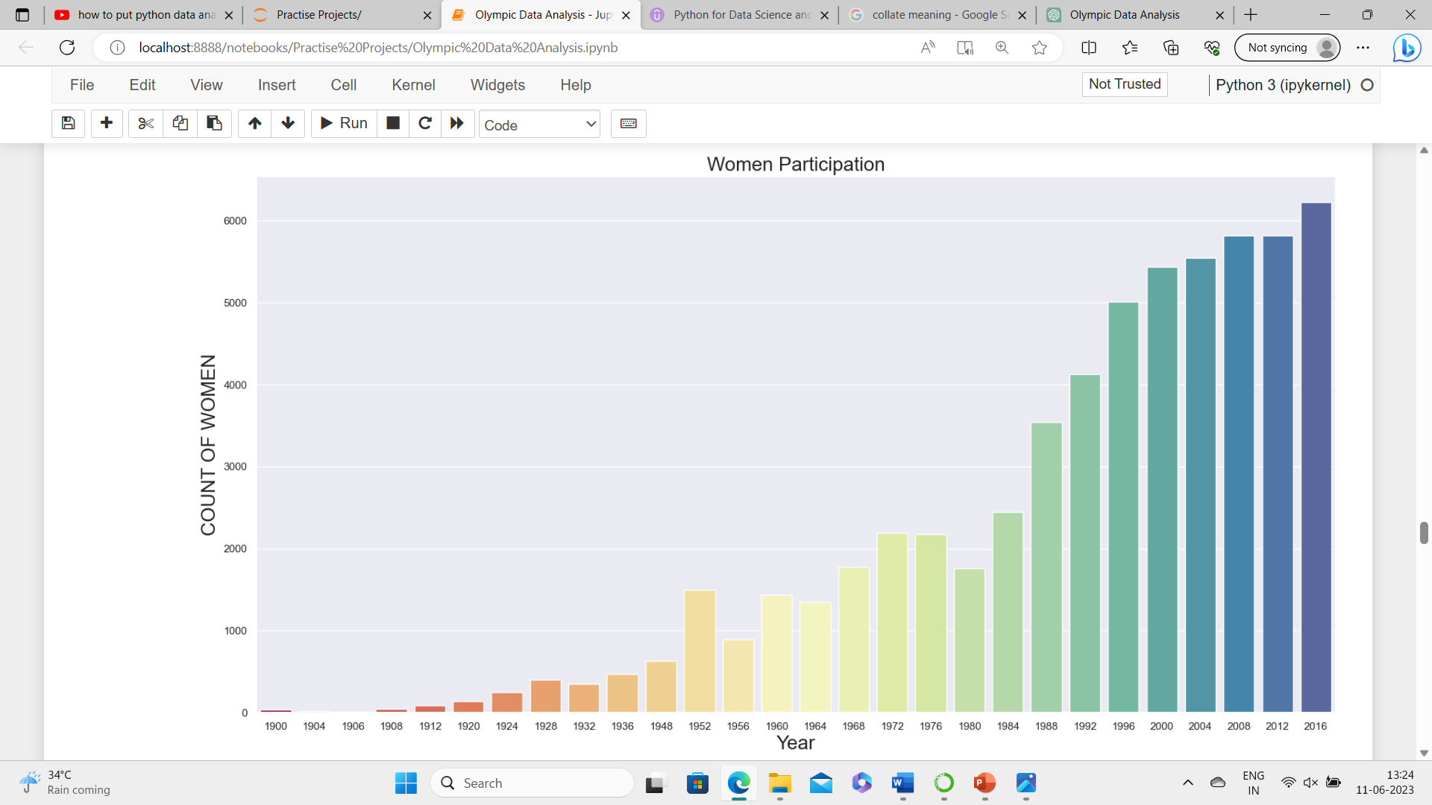
Female Athletes Participation

Slide 6
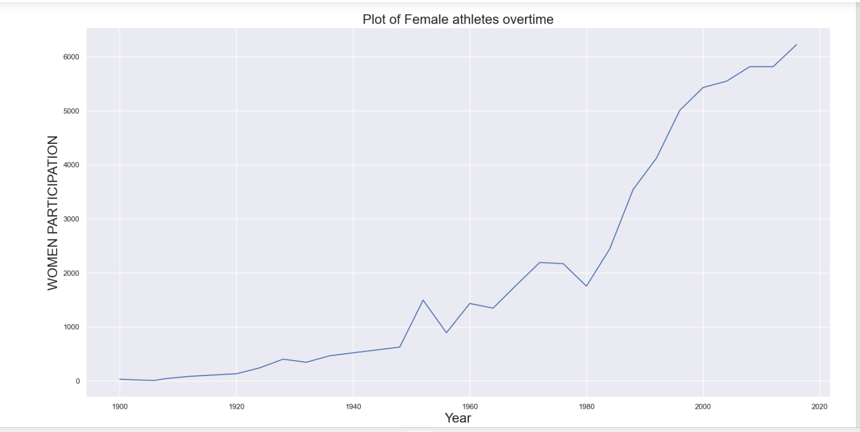
Variation of Female Athletes Participation Over the Years

Slide 7
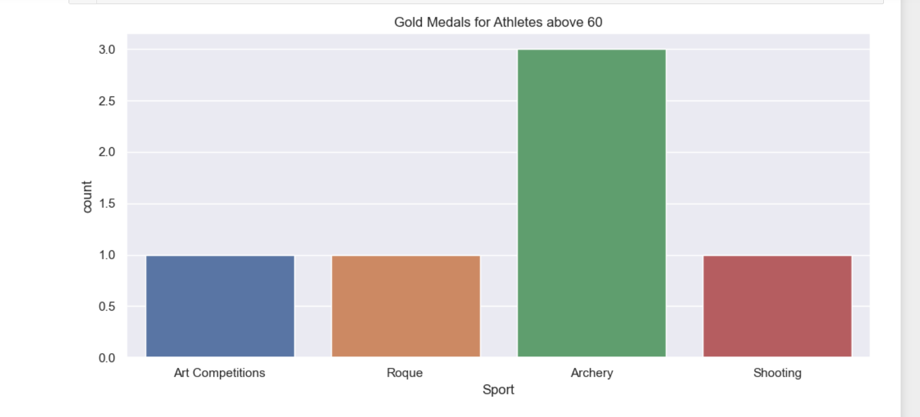
Gold Medals Won by Athletes Over 60

Slide 8
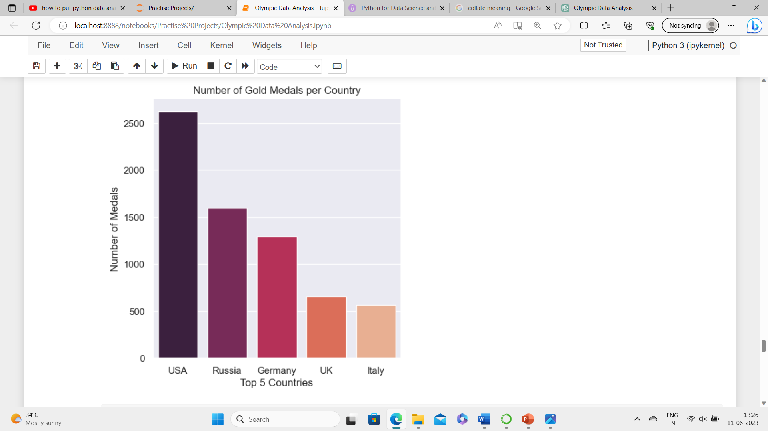
Number of Gold Medals Won by Countries

Slide 9
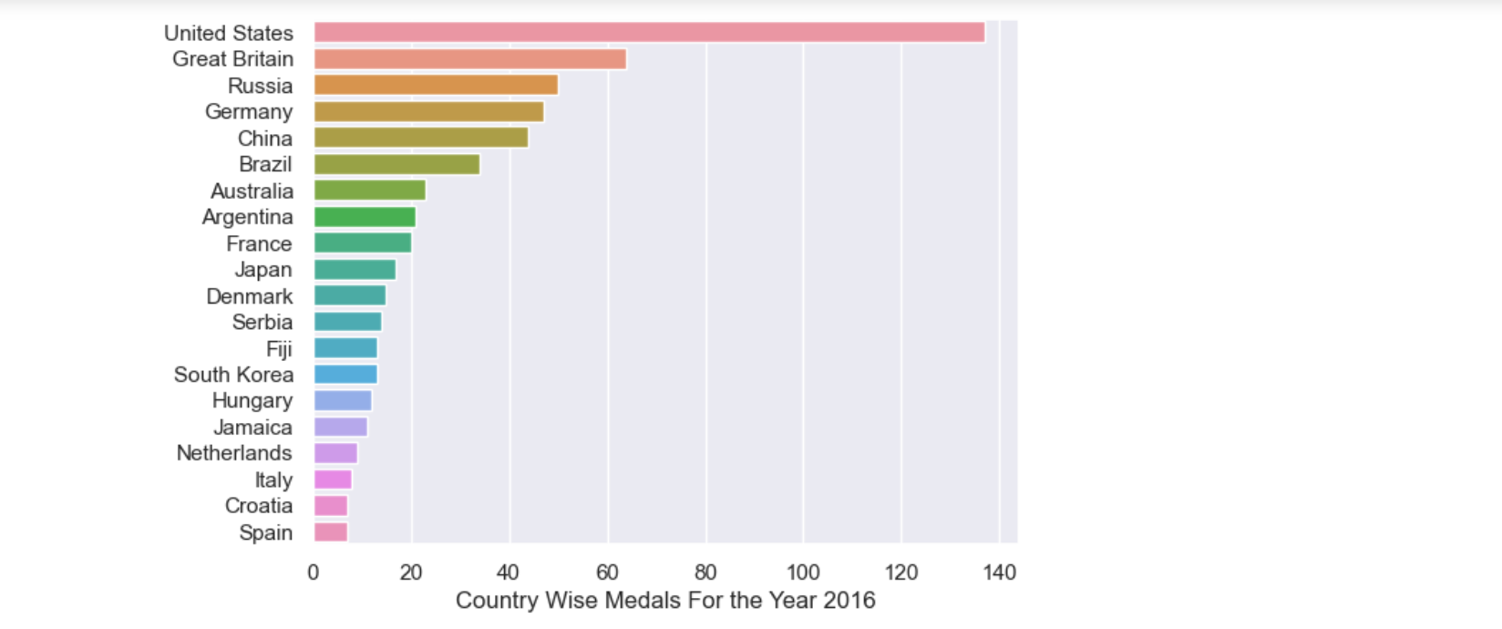
Total No of Medals Won by Countries

Slide 10
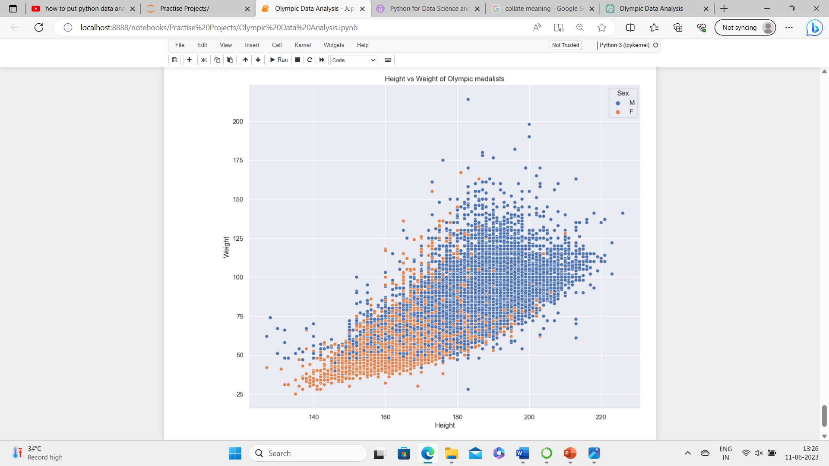
Distribution of Height(cm) of Athletes

